Slide 1
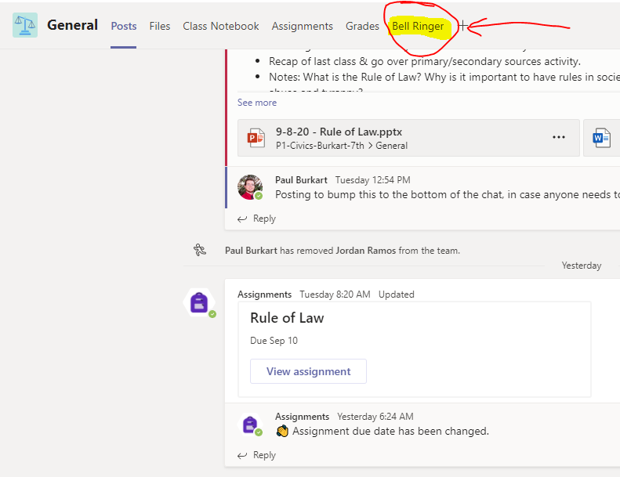
BELL RINGER

Slide 2
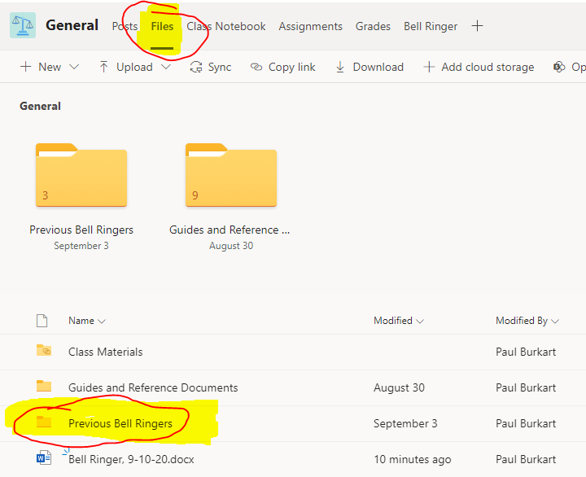
PREVIOUS BELL RINGERS

Slide 3
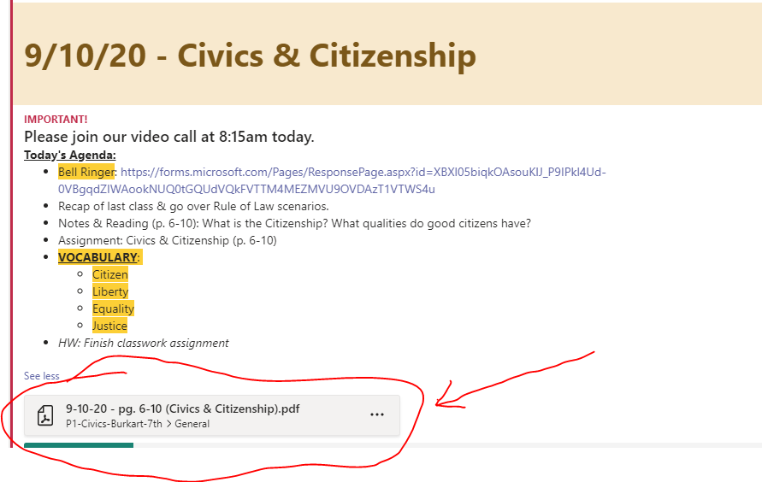
TODAY’S READING

Slide 4
IN YOUR NOTES…
What do you think “citizenship” means?
What are some qualities that a good citizen might have?

Slide 5
CORNELL NOTES
TOPIC & DATE
Vocab/Key Idea #1
Detailed notes for vocab/idea #1
Vocab/Key Idea #2
Detailed notes for vocab/idea #2
Summary

Slide 6
CORNELL NOTES
CITIZENSHIP (p. 6-10)
Citizen
A legally recognized member of a country.
Values
Ideas that people hold dear and try to live by.
Citizens have different roles and jobs to help preserve freedom and ensure justice & equality for all Americans.

Slide 7
CORNELL NOTES
CITIZENSHIP (p. 6-10)
Equality
Everyone has the same right to enjoy the benefits granted to all.
Liberty
Freedoms guaranteed to all.
Justice
Your rights and freedoms cannot be taken away.
Citizens have different roles and jobs to help preserve freedom and ensure justice & equality for all Americans.

Slide 8
CLASSWORK ASSIGNMENT
Go to “Assignments → Civics & Citizenship (p. 6-10)”
We will work together in groups to complete this assignment.

